Slide 1
jQuery Mobile
Lesson 06 : Using the Content Formatting Tools
Notes:
Add instructor notes here.

Slide 2
Lesson Objectives
In this lesson, you will learn :
Using layout grids
Using collapsible content blocks
Using collapsible sets
Using themes
Notes:
Add instructor notes here.

Slide 3
6.1 : Using layout grids Using Columns and grids
Grid Layout:
Are useful for displaying any content that must be presented side-by-side
Have no margins, no padding, no borders, and no background
Are 100 percent wide and can have multiple rows and columns
jQuery Mobile allows to build CSS-based columns through a block style class convention called ui-grid.
Four preset configurations layouts can be used :
two-column (using the ui-grid-a class)
three-column (using the ui-grid-b class)
four-column (using the ui-grid-c class)
five-column (using the ui-grid-d class)
Within the grid container, child elements are assigned ui-block-a/b/c/d/e
This makes each "block" element float side-by-side, forming the grid.
Notes:
jQuery Mobile helps us in creating web sites targeted towards mobile devices. Formatted content is important to provide users-on-the-move with an accessible way to reference and gather the information you are providing on your website.
However, the screens on most mobile devices are relatively small and thus we must try to communicate and provide information in an effective way. For this, the framework provides a number of tools, widgets, and components to help us in formatting our content and making it look attractive. For example, the framework provides collapsibles & accordions to manage content on smaller screens.
Using columns and grids:
Say, there is a need for placing certain elements in a particular position on our web page. The jQuery Mobile Framework allows us to create a grid layout by providing set of layout grids built in, ranging from two to five columns.
Having said this, using multiple column layouts isn't generally recommended on a mobile device because of the narrow screen width.
Grids are 100% width, completely invisible (no borders or backgrounds) and don't have padding or margins, so they shouldn't interfere with the styles of elements placed inside them.
Layout grids are based on a div structure: create a div to contain the grid, and then add the cell divs inside. The containing div is given a class ui-grid class: ui-grid-a for 2 columns, ui-grid-b for three columns, and so forth, all the way to ui-grid d for 5 columns. Cell divs are given ui-block classes based on their order: ui-block-a for first, ui-block-b for second, and so forth, all the way up to ui-block-e for fifth.

Slide 4


6.1 : Using layout grids Using Columns and grids : Examples
To create a Two-column layout:
Creating a simple grid with one row and two columns, each containing a button
<div class="ui-grid-a">
<div class="ui-block-a"><p>This is block A</p></div>
<div class="ui-block-b"><p>This is block B</p></div>
</div>
<div class="ui-grid-a">
<div class="ui-block-a">
<button type=“submit”>Button1</button>
</div>
<div class="ui-block-b">
<button type="submit">Button2</button>
</div>
</div>
Notes:
For example, to create a two-column layout, we need to give a div the ui-grid-a class.
<div class="ui-grid-a">
<!-- blocks go here -->
</div>
With this, jQuery mobile tells the children divs (ie blocks or cells) that they need to occupy 50% of the screen.
To add cells to the grid, we need to specify the ui-block-X class to each cell. The first block will be assigned the letter a, the second one will have b, and so on. Thus we can create a maximum of 5 columns.
<div class="ui-grid-a">
<div class="ui-block-a"></div>
<div class="ui-block-b"></div>
</div>
Example : To create a five-column layout:
<div class="ui-grid-d">
<div class="ui-block-a"><p>This is block A</p></div>
<div class="ui-block-b"><p>This is block B</p></div>
<div class="ui-block-c"><p>This is block C</p></div>
<div class="ui-block-d"><p>This is block D</p></div>
<div class="ui-block-e"><p>This is block E</p></div>
</div>

Slide 5
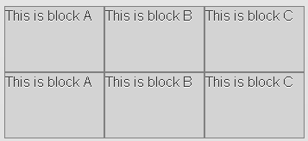
6.1 : Using layout grids Using Columns and grids : Examples
To create a Three-column layout, multiple rows:
<div class="ui-grid-b">
<!-- First Row with 3 Columns -->
<div class="ui-block-a"><p>This is block A</p></div>
<div class="ui-block-b"><p>This is block B</p></div>
<div class="ui-block-c"><p>This is block C</p></div>
<!-- Second Row with 3 Columns -->
<div class="ui-block-a"><p>This is block A</p></div>
<div class="ui-block-b"><p>This is block B</p></div>
<div class="ui-block-c"><p>This is block C</p></div>
</div>
Notes:
For example, to create a two-column layout, we need to give a div the ui-grid-a class.
<div class="ui-grid-a">
<!-- blocks go here -->
</div>
With this, jQuery mobile tells the children divs (ie blocks or cells) that they need to occupy 50% of the screen.
To add cells to the grid, we need to specify the ui-block-X class to each cell. The first block will be assigned the letter a, the second one will have b, and so on. Thus we can create a maximum of 5 columns.
<div class="ui-grid-a">
<div class="ui-block-a"></div>
<div class="ui-block-b"></div>
</div>

Slide 6

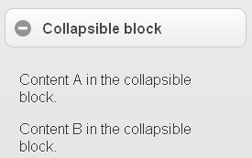
6.2 : Using collapsible content blocks Collapsible blocks
To create a collapsible block of content, create a container and add the data-role="collapsible" attribute.
Adding the data-collapsed="true" attribute to the container determines if collapsible block can be expanded or not.
<div data-role="collapsible">
<h1>Collapsible block</h1>
<p>Content A in the collapsible block.</p>
<p>Content B in the collapsible block.</p>
</div>
<div data-role="collapsible" data-collapsed="true">
Notes:
A second manner of formatting content is only to show a portion of the content, which provides users with an overview and the option to read more. Since most mobile devices have a small screen, it's important to keep page length relatively short and to the point. Collapsible content blocks offer a great way to handle this functionality. The jQuery Mobile framework offers a data-role for collapsible content, which converts a header element and associated content into a collapsible block.
The jQuery Mobile framework needs a heading element (can be from h1 through h6) to be present inside the container. This will be styled like a clickable button, and a plus (+) symbol will be added to its left to indicate it's expandable. Once this is clicked, the content shows and a minus (-) symbol will replace the + to indicate it's collapsible.

Slide 7
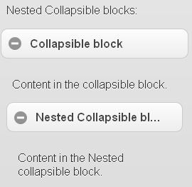
6.2 : Using collapsible content blocks Nested Collapsible blocks
Collapsible blocks can also be nested
<p>Nested Collapsible blocks:</p>
<div data-role="collapsible">
<h1>Collapsible block</h1>
<p>Content in the collapsible block.</p>
<div data-role="collapsible">
<h1>Nested Collapsible block</h1>
<p>Content in the Nested collapsible block.</p>
</div>
</div>

Slide 8
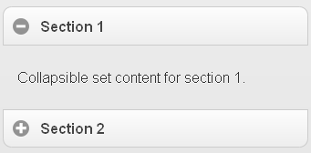
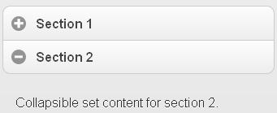
6.3 : Using collapsible sets Collapsible sets (Accordions)
Collapsible sets start with the same markup as collapsible blocks.
Add a parent wrapper with a data-role="collapsible-set" attribute around a number of collapsibles
The framework styles these to look like a visually grouped widget - like an accordion so only one section can be open at a time.
By default, all the sections will be collapsed
<div data-role="collapsible-set">
<div data-role="collapsible“ >
<set ch3>Section 1</h3>
<p>Collapsible ontent for section 1.</p>
</div>
<div data-role="collapsible">
<h3>Section 2</h3>
<p>Collapsible set content for section 2.</p>
</div>
</div>
Notes:
Collapsible sets are a certain number of collapsible blocks grouped together so that they act like an accordion widget: all other blocks close when a new one is opened.

Slide 9
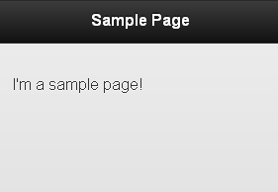
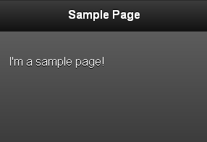
6.4 : Using themes Theming system
Theme control is built directly into jQuery Mobile.
Swatches are controlled with the data-theme attribute.
<div data-role="page" id="page” >
<div data-role="header">
<h1>Sample Page</h1>
</div>
<div data-role="content">
<p>I'm a sample page!</p>
</div>
</div>
<div data-role="page" id="page" data-theme=“a">
<div data-role="header">
….
</div>
Notes:
So far, we have seen how to build great looking websites with jQuery Mobile. Buttons are glossy, gradients are smooth, and the overall interface is elegant. However, depending on design requirements, you may want to blend colors to match your company colors or brand, or highlight or mute buttons and tabs. In short, you may want control of the look and feel of your jQuery Mobile website.
jQuery Mobile uses CSS to control the visual layout of content on the screen. There are two main parts of the main jQuery Mobile CSS document:
Structure, which controls the position, padding, and margins for elements such as buttons and tabs on the screen.
Theme, which controls specific visual elements such as fonts, colors, gradients, shadows, and corners. Modifying a theme allows you to control the visual elements of objects such as buttons.
Each theme can include one or more swatches. A swatch sets the color values for bars, content blocks, buttons, and list items in a theme. You can use swatches to easily switch among alternative color schemes for the main theme. The default CSS document that comes with jQuery Mobile has a theme with a set of five swatches that are named a, b, c, d, and e. By convention swatch a is the highest level of visual priority

Slide 10
Demo
Grids.html
CollapsibleBlocks.html
CollapsibleSets.html
Theme.html
Notes:
Code for these demos has been discussed in the earlier slides.
Pls. see the demos in lesson-6 folder.
Add instructor notes here.

Slide 11
X.X: [Topic] Lab
Lab Topic
Notes:
Add the notes here.
Add instructor notes here.

Slide 12
Summary
In this lesson, you learnt:
Using layout grids
Using collapsible content blocks
Using collapsible sets
Using themes
Notes:
Add the notes here.
Add instructor notes here.

Slide 13
Review Question
Question 1 : The maximum number of columns that a grid can hold is:
Option 1 : 2
Option 2 : 5
Option 3 : No limit – any number!
Question 2 : Collapsible sets (accordions) start with the same markup as collapsible blocks.
True/False
Question 3: To create the first row in a grid, we must specify _______ in the
Option 1 : ui-row-a
Option 2 : ui-cell-a
Option 3 : ui-block-a
Option 4 : ui-row-1
Notes:
Add the notes here.
Add instructor notes here.
Answer 1 : option 2 - 5
Answer 2 : true
Answer 3 : option 3

